Slide 1
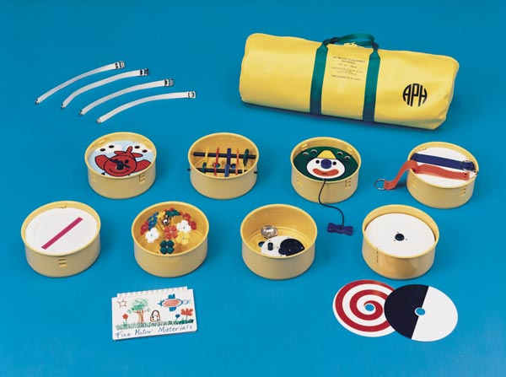
Fine Motor Development Materials: Twist, Turn, and Learn
American Printing House for the Blind
Catalog Number: 1-08420-00

Slide 2
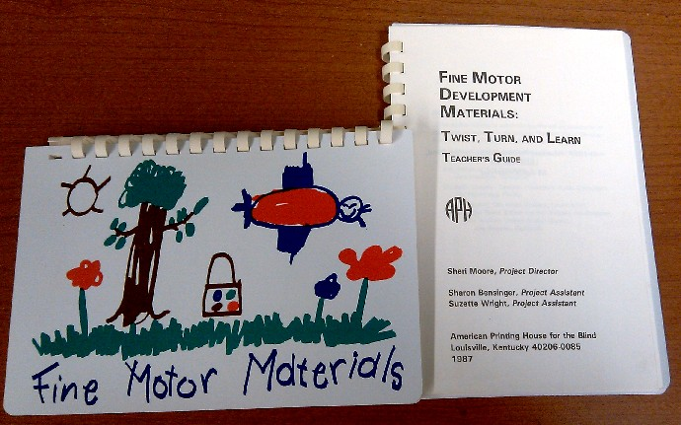
Teacher’s Guide
Comes with a teacher’s guidebook that contains ideas and suggestions for utilizing the modules.

Slide 3
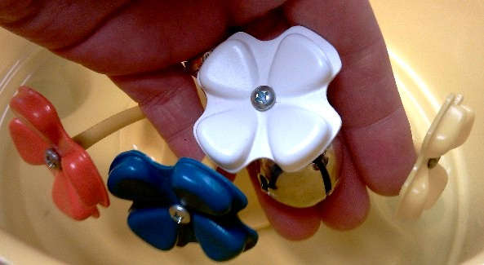
FUN FLOWERS:
A module mounted with multicolored flowers with bells. Helps a child to develop grasp/release, reaching, raking, hand/eye coordination, finger manipulation/ coordination, and tactual discrimination.

Slide 4
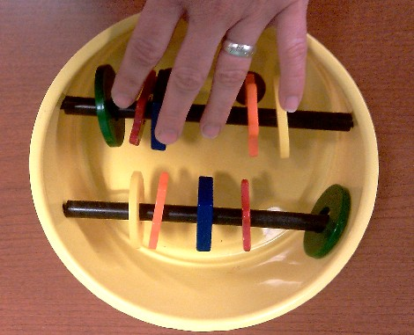
RATTLES:
Variously shaped, multicolored rattles are mounted inside this module on two rods. Reaching-grasping, pincer grasp, finger manipulation/coordination, and tactual discrimination are developed by this module.

Slide 5
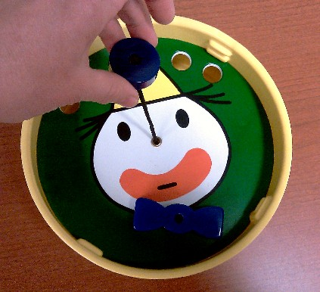
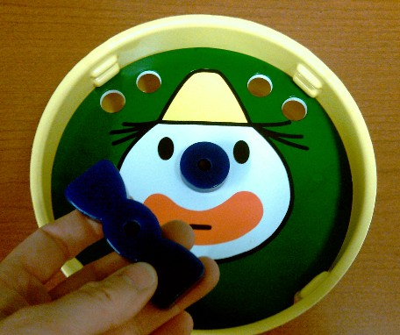
CLOWN PULL:
A colorful face appears in this module. Pulling alternately on the clown’s nose or bow tie causes a bell to sound. Helps the student in developing palmar grasp/release, and eye-hand coordination.

Slide 6
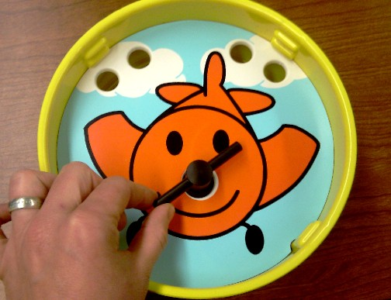
HAPPY AIRPLANE:
This module contains a picture of a cheerful airplane. When the plane’s propeller is spun, a bell chimes. Develops the student’s wrist rotation, palmar grasp, grasp/release, and reaching-grasping.

Slide 7
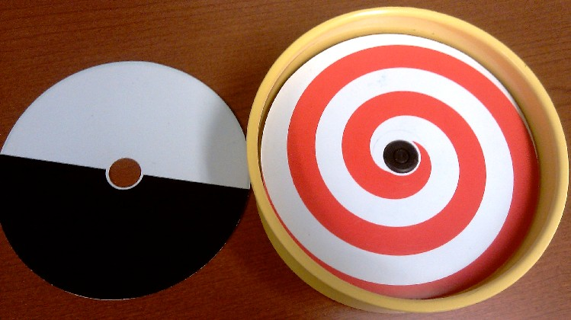
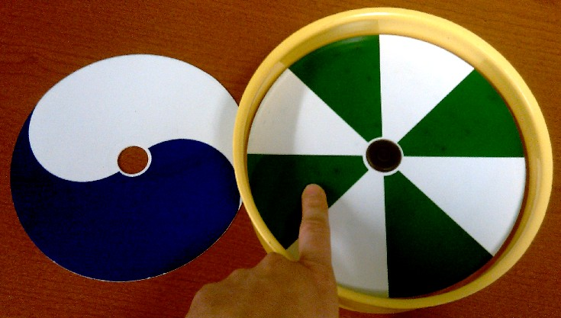
SPINNER WITH OVERLAYS:
Four brightly colored geometric patterns come on two discs designed to be overlaid on this module’s spinner. Pincer grasp, finger manipulation/coordination, visual discrimination, raking, and eye-hand coordination are developed.

Slide 8
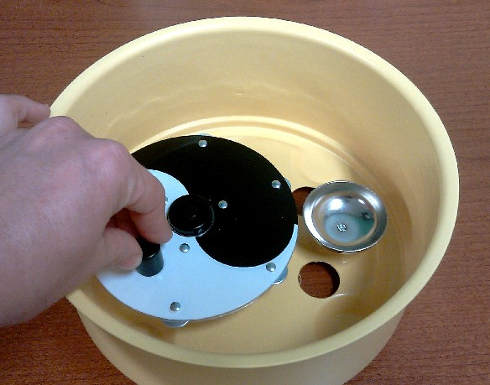
BELL CHIME:
A module mounted with a circular disk. The disk is rotated by a handle, causing a bell to ring. Helps the student to develop pincher grasp, wrist rotation, and finger manipulation/coordination.

Slide 9
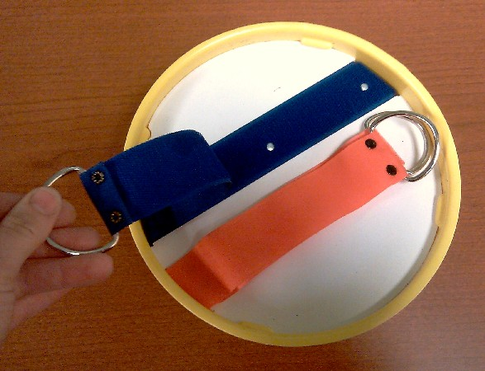
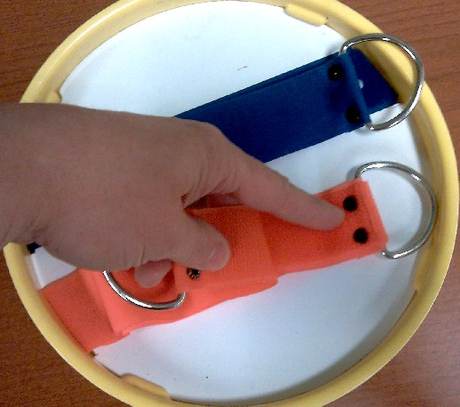
HOOK/LOOP PULL:
Two colorful strips of hook/loop material with handles for grasping are fastened to this module. This helps the child develop grasp/release, pincer grasp, two-handed grasp, and two-handed pull.

Slide 10
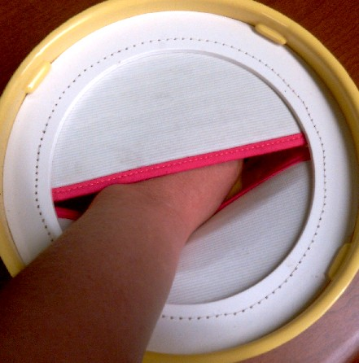
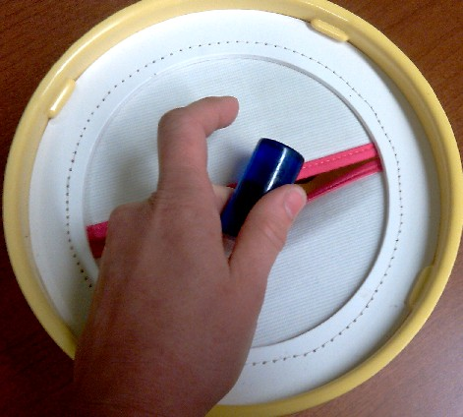
HIDDEN POCKET:
This module has an elastic cloth pocket for hiding various objects. Helps the student to develop search techniques, tactual discrimination, and reaching/grasping skills.

Slide 11
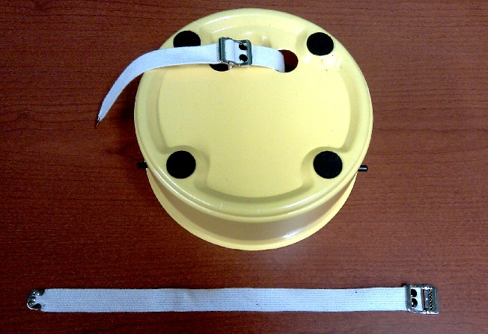
Straps
Also included is a set of straps designed to allow the modules to be hung on playpens or cribs.

