Slide 1
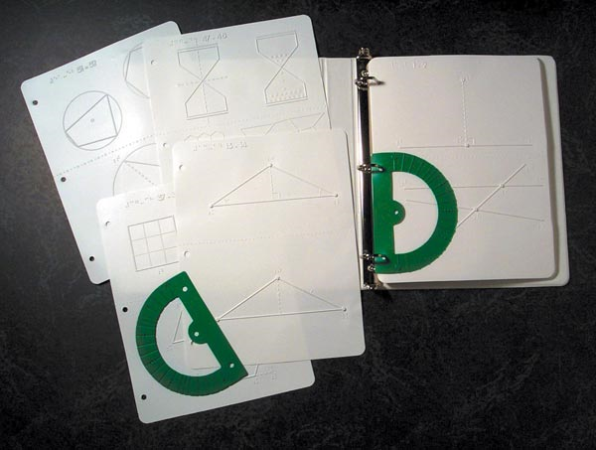
Geometry Tactile Graphics Kit

Slide 2
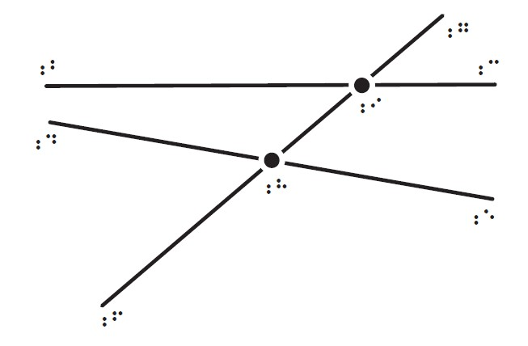
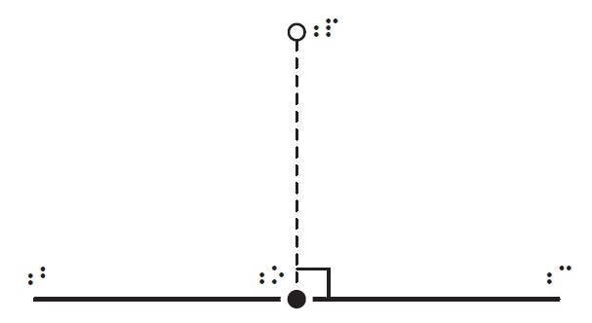
Drawings 1 - 2
#1. Perpendicular to a line
#2. Skew lines and transversal

Slide 3
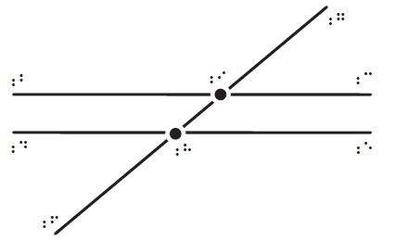
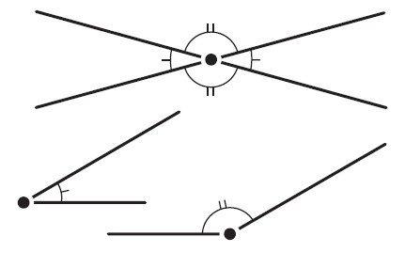
Drawings 3 - 4
#3. Parallel lines and transversal
#4. Marking congruent angles

Slide 4
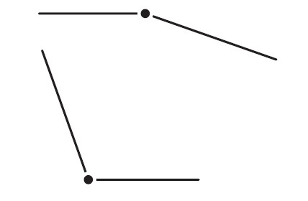
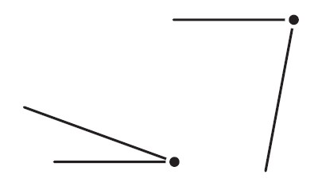
Drawings 5 - 6
#5. Acute angles
#6. Obtuse angles

Slide 5
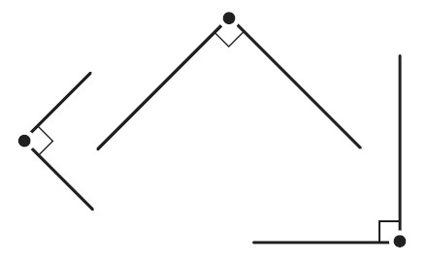
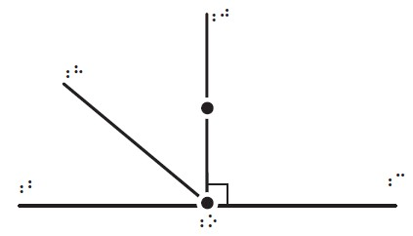
Drawings 7 - 8
#7. Right angles and their marking
#8. Adding angles

Slide 6
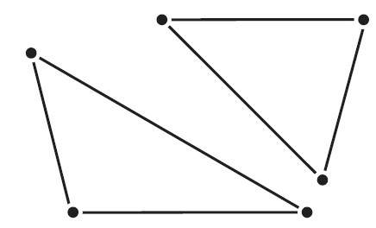
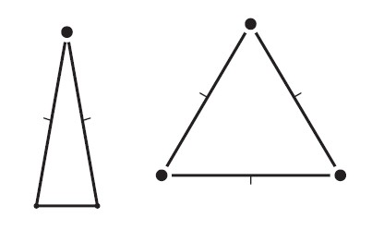
Drawings 9 - 10
#9. Types of triangles
#10. Isosceles triangles

Slide 7
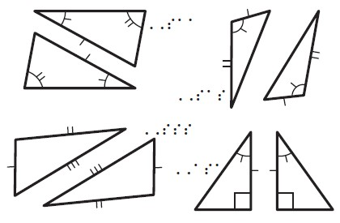
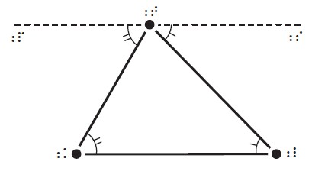
Drawings 11 - 12
#11. Proof of interior angle theorem
#12. Triangle congruences

Slide 8
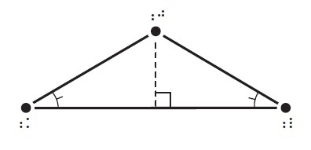
Drawings 13 - 14
#13. Triangle with two congruent angles
#14. Triangle with two congruent sides

Slide 9
Drawings 15 - 16
#15. Exterior angles
#16. Angles opposite an exterior angle

Slide 10
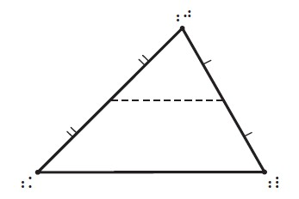
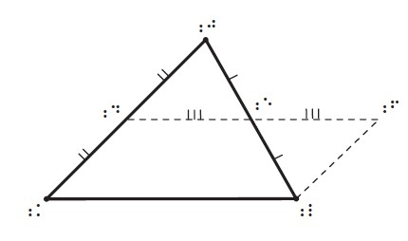
Drawings 17 - 18
#17. Connecting midpoints of two sides
#18. Proving the midpoint theorem

Slide 11
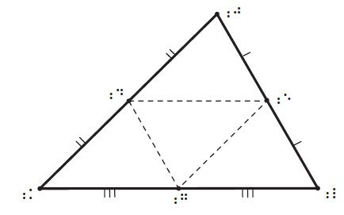
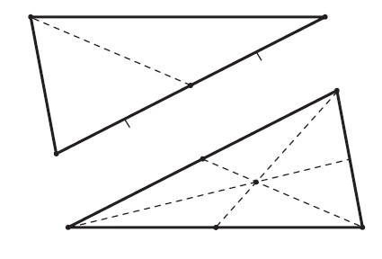
Drawings 19 - 20
#19. Connecting all three midpoints
#20. Medians

Slide 12
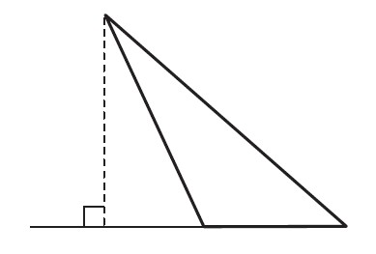
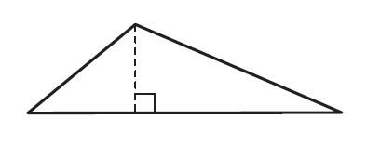
Drawings 21 - 22
#21. Altitude from the largest angle
#22. Second altitude

Slide 13
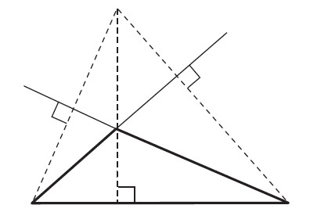
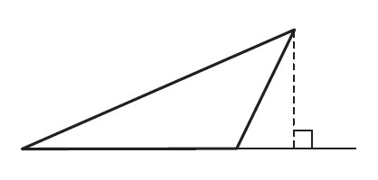
Drawings 23 - 24
#23. Third altitude
#24. Meeting of the altitudes

Slide 14
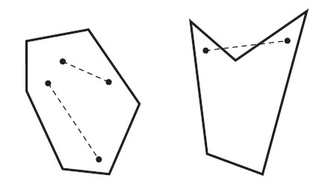
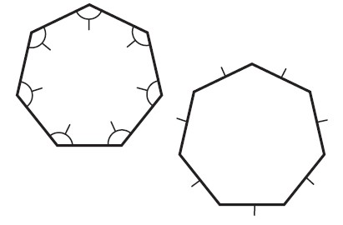
Drawings 25 - 26
#25. Convex and concave
#26. Regular polygon

Slide 15
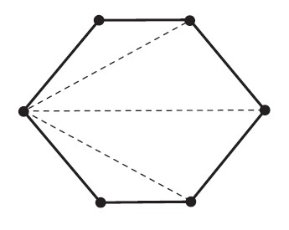
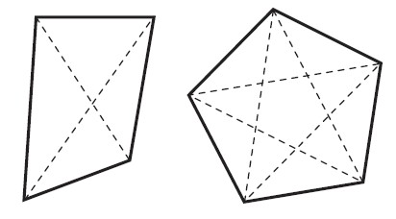
Drawings 27 - 28
#27. Irregular quadrilateral and regular pentagon
#28. Using diagonals to make triangles

Slide 16
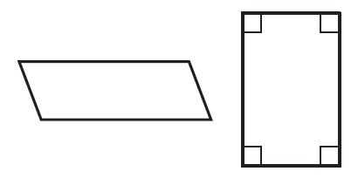
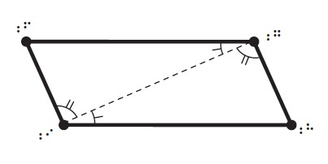
Drawings 29 - 30
#29. Parallelograms
#30. Proving opposite sides of a parallelogram congruent

Slide 17
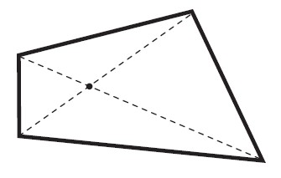
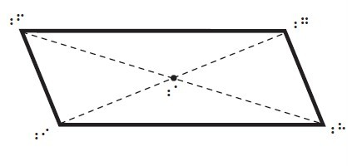
Drawings 31 - 32
#31. Diagonals that do not bisect each other
#32. Diagonals that bisect each other

Slide 18
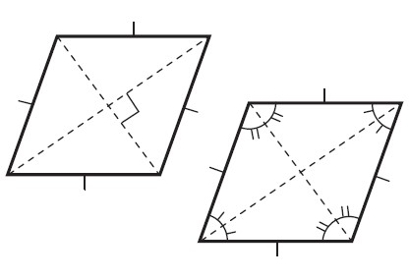
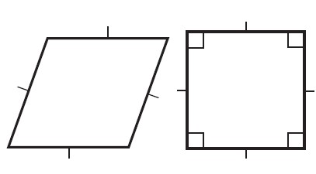
Drawings 33 - 34
#33. Rhombus and square
#34. Diagonals of a rhombus

Slide 19
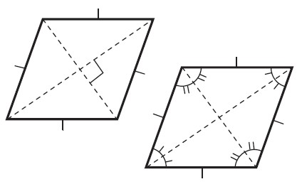
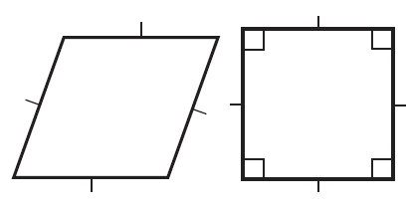
Drawings 35 - 36
#35. Trapezoids
#36. Connecting midpoints of a quadrilateral

Slide 20
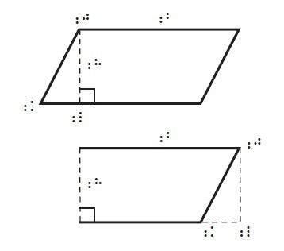
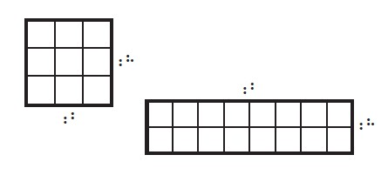
Drawings 37 - 38
#37. Area of rectangles
#38. Area of a parallelogram

Slide 21
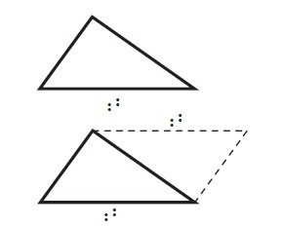
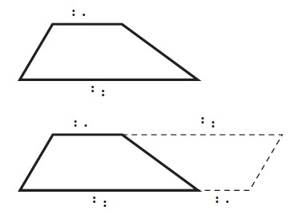
Drawings 39 - 40
#39. Area of a triangle
#40. Area of a trapezoid

Slide 22
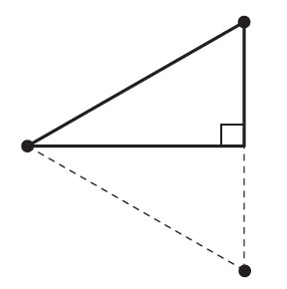
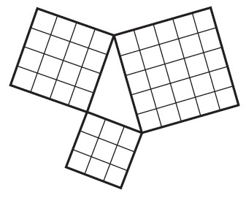
Drawings 41 - 42
#41. The 30° -60° -90° triangle
#42. Pythagorean Theorem illustration

Slide 23
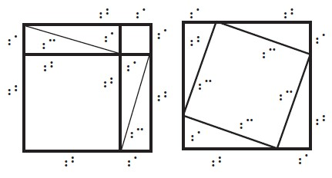
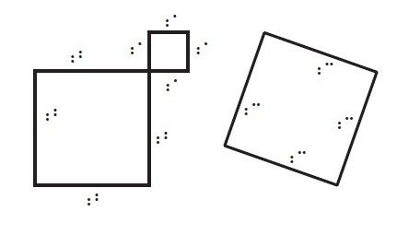
Drawings 43 - 44
#43. Proof of Pythagorean Theorem, part 1
#44. Proof of Pythagorean Theorem, part 2

Slide 24
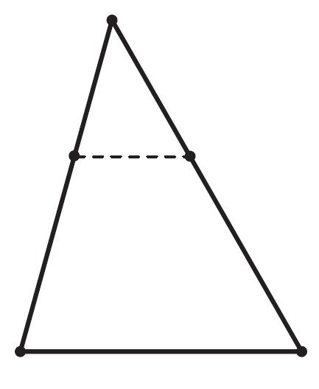
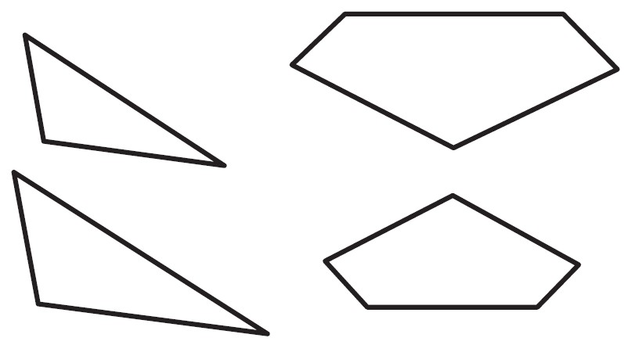
Drawings 45 - 46
#45. Similar polygons
#46. Proportionality in a triangle

Slide 25
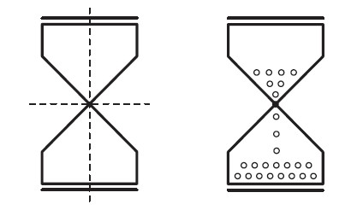
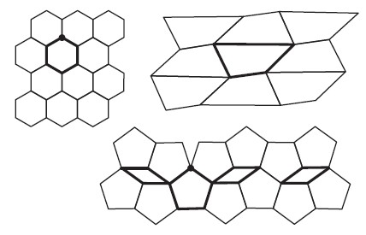
Drawings 47 - 48
#47. Symmetry
#48. Area-filling

Slide 26
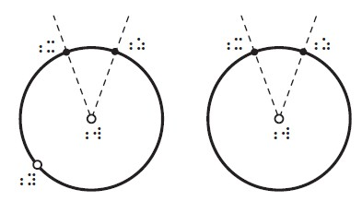
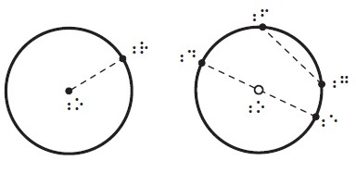
Drawings 49 - 50
#49. Radius and chords
#50. Minor and major arcs

Slide 27
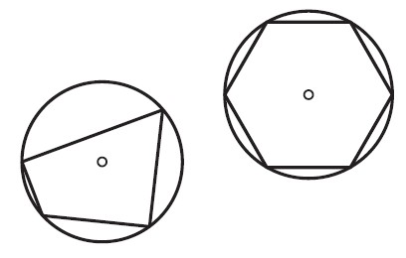
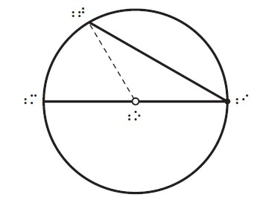
Drawings 51 - 52
#51. Inscribed polygons
#52. Inscribed angle proof

