Slide 2
A tangram puzzle consists of seven pieces:
Large Triangles
(2) Small Triangles
(1) Medium Triangle
Square
(1) Parallelogram

Slide 3
The use of tangram puzzles supports skills that are consistent with national standards:
Recognize, name, build, draw, compare, and sort two- or three-dimensional shapes
Describe attributes and parts of two- or three-dimensional shapes
Investigate and predict the results of putting together and taking apart two- or three-dimensional shapes

Slide 4
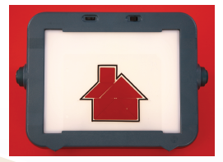
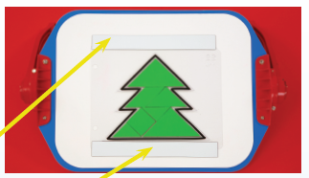
Types of Puzzle Pieces
Magnetic-Backed Foam
Acrylic
Thick Foam

Slide 5
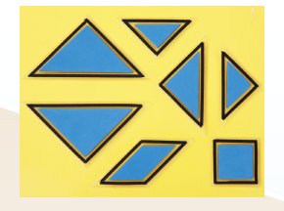
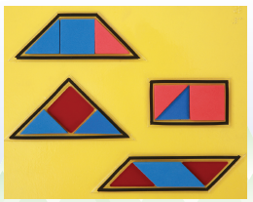
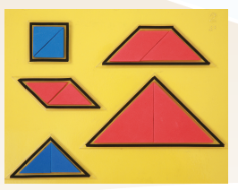
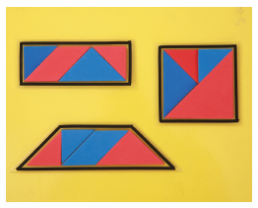
1
3
Puzzle Frames
1-4
Puzzle # indicates number of pieces needed
2
4

Slide 6
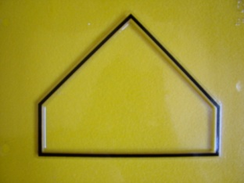
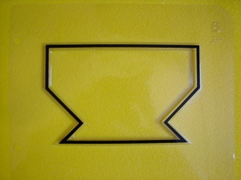
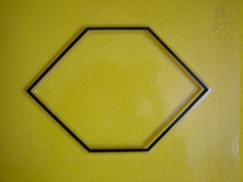
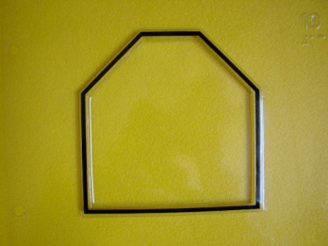
Puzzle Frames
5-26
5
6
Each puzzle frame requires all 7 pieces
7
8
9
10
11
12
13

Slide 7
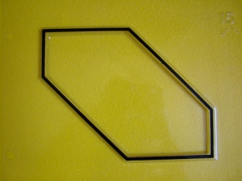
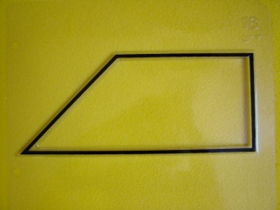
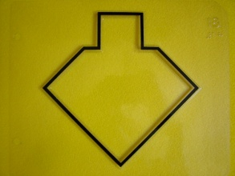
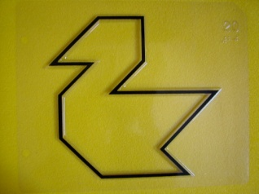
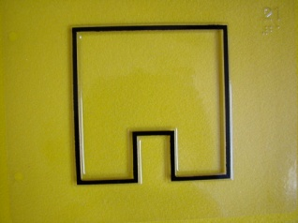
14
15
Puzzle Frames
5-26
16
17
Continued
18
19
20
21
22
23
24
25
26

Slide 8
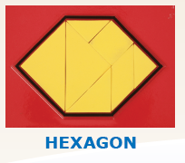
Naming Tangram Puzzles

Slide 9
Tangram Rules

Slide 10
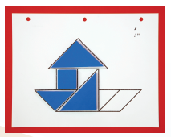
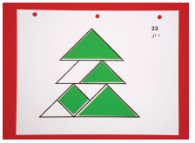
Solution Pages

Slide 11
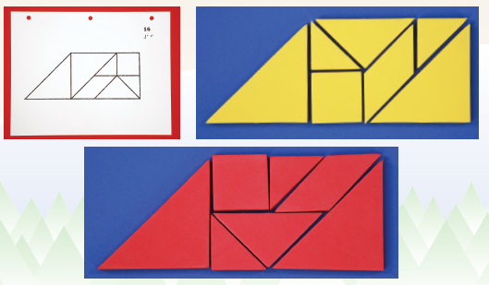
Multiple Solutions

Slide 12
Shapes, Angles, and Sides

Slide 13
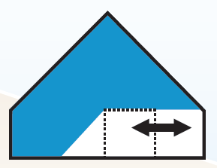
Flips, Turns, and Slides

Slide 14
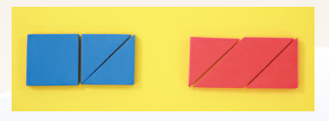
Congruent Shapes

Slide 15
Convex vs. Concave Polygons

Slide 16
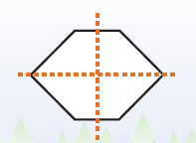
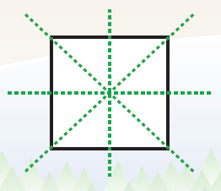
Symmetry

Slide 17
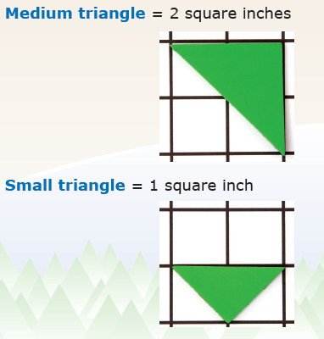
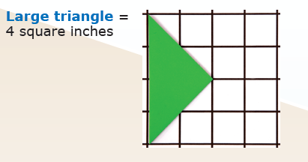
Area & Perimeter

Slide 18
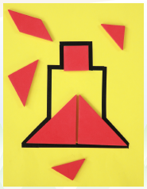
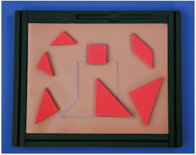
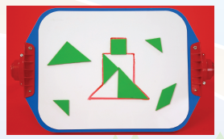
Creating Tangram Puzzles
Graphic Art Tape
Small-In-One
Foam Frame
Draftsman

Slide 19
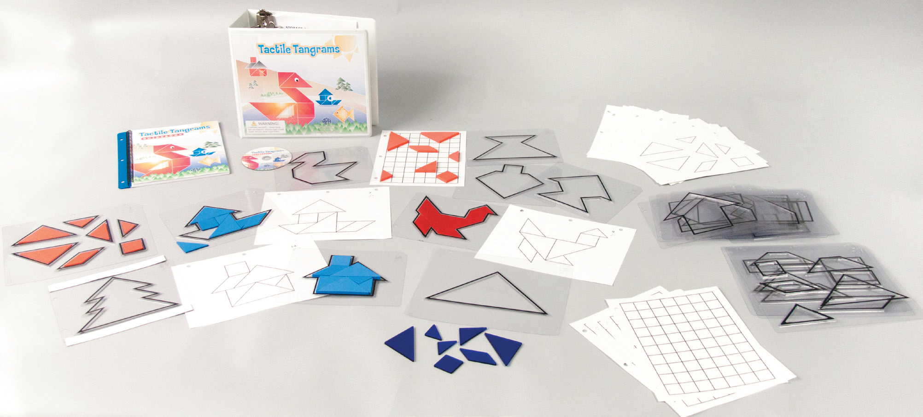
Complete Kit

Slide 20
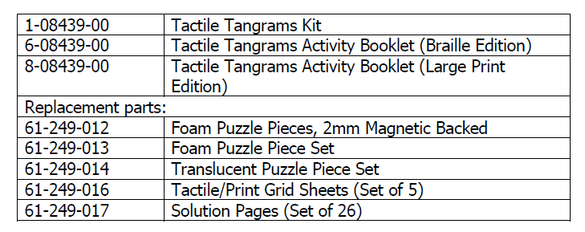
Product Contents and Replacement Parts

Slide 21
Tactile Tangrams
If you have questions about this product, please contact:
Karen J. Poppe,
Tactile Graphics Project Leader
kpoppe@aph.org
(502) 899-2322

